Slide 1
Forestry Merit Badge
Troop 344 and 9344
Pemberville, OH

Slide 2
Forestry Merit Badge Requirements
Prepare a field notebook, make a collection, and identify 15 species of trees, wild shrubs, or vines in a local forested area. Write a description in which you identify and discuss the following:
The characteristics of leaf, twig, cone, or fruiting bodies
The habitat in which these trees, shrubs or vines are found.
The important ways each tree, shrub, or vine is used by humans or wildlife and whether the species is native or was introduced to the area. If it is not native, explain whether it is considered invasive or potentially invasive.

Slide 3
Forestry Merit Badge Requirements
Do ONE of the following:
Collect and identify wood samples of 10 species of trees. List several ways the wood of each species can be used.
Find and examine three stumps, logs, or core samples that show variations in the growth rate of their ring patterns. In the field notebook you prepared for requirement 1, describe the location or origin of each example (including elevation, aspect, slope, and the position on the slope), and discuss possible reasons for the variations in growth rate. Photograph or sketch each example.
Find and examine two types of animal, insect, or disease damage to trees. In the field notebook you prepared for requirement 1, identify the damage, explain how the damage was caused, and describe the effects of the damage on the trees. Photograph or sketch each example.

Slide 4
Forestry Merit Badge Requirements
Do the following:
Describe contributions forests make to:
Our economy in the form of products.
Our social well-being, including recreation
Soil protection and increased fertility.
Clean water.
Clean air. (carbon cycling, sequestration)
Wildlife habitat
Fisheries habitat
Threatened and endangered species of plants and animals
Tell which watershed or other source your community relies on for its water supply.

Slide 5
Forestry Merit Badge Requirements
Describe what forest management means, including the following:
Multiple-use management
Sustainable forest management
Even-aged and uneven-aged management and silvicultural systems associated with each type.
Intermediate cuttings.
The role of prescribed burning and related forest management practices.

Slide 6
Forestry Merit Badge Requirements
With your parent's and counselor's approval, do ONE of the following:
Visit a managed public or private forest area with its manager or a forester familiar with it. Write a brief report describing the type of forest, the management objectives, and the forestry techniques used to achieve the objectives.
Take a trip to a logging operation or wood-using industrial plant and write a brief report describing:
The species and size of trees being harvested or used and the location of the harvest area or manufacturer.
The origin of the forest or stands of trees being utilized (e.g., planted or natural)
The forest's successional stage. What is its future?
Where the trees are coming from (land ownership) or where they are going (type of mill or processing plant)
The products that are made from the trees
How the products are made and used.
How waste materials from the logging operation or manufacturing plant are disposed of or utilized.
Take part in a forest-fire prevention campaign in cooperation with your local fire warden, state wildfire agency, forester, or counselor. Write a brief report describing the campaign, how it will help prevent wildfires, and your part in it.

Slide 7
Forestry Merit Badge Requirements
In your camp, local recreation area (park or equivalent), or neighborhood, inventory the trees that may be a hazard to structures or people. Make a list by area (campsite, road, trail, street, etc.). Note the species and hazardous condition, and suggest a remedy (removal or trimming). Make your list available to the proper authority or agency.
Do the following:
Describe the consequences to forests that result from FIVE of the following elements: wildfire, absence of fire, destructive insects, loss of pollinating insect population, tree diseases, air pollution, overgrazing, deer or other wildlife overpopulation, improper harvest, and urbanization.
Explain what can be done to reduce the consequences you discussed in 7a.
Describe what you should do if you discover a forest fire and how a professional firefighting crew might control it. Name your state or local wildfire control agency.
Visit one or more local foresters and write a brief report about the person (or persons). Or, write about a forester's occupation including the education, qualifications, career opportunities, and duties related to forestry.

Slide 8
Requirement 1
Prepare a field notebook, make a collection, and identify 15 species of trees, wild shrubs, or vines in a local forested area. Write a description in which you identify and discuss the following:
The characteristics of leaf, twig, cone, or fruiting bodies
The habitat in which these trees, shrubs or vines are found.
The important ways each tree, shrub, or vine is used by humans or wildlife and whether the species is native or was introduced to the area. If it is not native, explain whether it is considered invasive or potentially invasive.

Slide 9
Requirement 1
Download the “Leaf Identification Key to 88 Ohio Trees” to help identify your collection of 15 trees, shrubs, or vines.

Slide 10
Requirement 1
Download the Trees of Ohio Field Guide and use the following slides for information on:
The characteristics of leaf, twig, cone, or fruiting bodies
The habitat in which these trees, shrubs or vines are found.
The important ways each tree, shrub, or vine is used by humans or wildlife and whether the species is native or was introduced to the area. If it is not native, whether it is considered invasive or potentially invasive.

Slide 11
Leaf Characteristics

Slide 12
Twig Characteristics

Slide 13
Pine Cone Characteristics

Slide 14
Fruiting Characteristics

Slide 15
Native, Exotic, and Invasive Species
Native species of plants are those that are the natural inhabitants of an area.
The fact that they have evolved over many generations in a forest means that each species has a clear niche in the ecosystem.
A native plant species interacts with other native species of plants and animals in balanced ways that help an ecosystem maintain a high degree of stability.

Slide 16
Native, Exotic, and Invasive Species
A nonnative species, also known as an exotic, is a species that has been introduced to a forest from somewhere else.
Some exotic species have little impact on other species.
The ginkgo tree, for example, is a native of China.
Imported into the United States more than 100 years ago, it grows well without seriously challenging native plants.

Slide 17
Native, Exotic, and Invasive Species
Nonnative species that spread aggressively and push out or kill native species are known as invasive species.
Kudzu plant choking out native vegetation on the entire hillside.

Slide 18
Requirement 2
Do ONE of the following:
Collect and identify wood samples of 10 species of trees. List several ways the wood of each species can be used.
Find and examine three stumps, logs, or core samples that show variations in the growth rate of their ring patterns. In the field notebook you prepared for requirement 1, describe the location or origin of each example (including elevation, aspect, slope, and the position on the slope), and discuss possible reasons for the variations in growth rate. Photograph or sketch each example.
Find and examine two types of animal, insect, or disease damage to trees. In the field notebook you prepared for requirement 1, identify the damage, explain how the damage was caused, and describe the effects of the damage on the trees. Photograph or sketch each example.

Slide 19
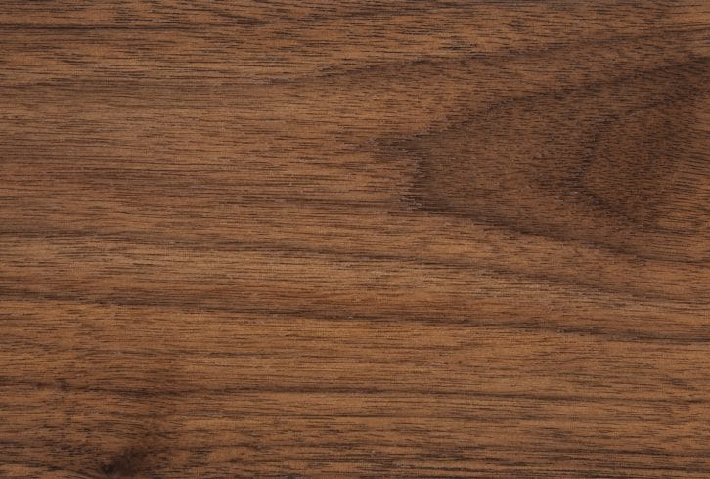
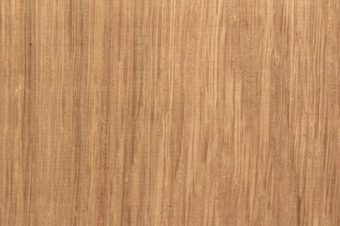
Requirement 2a
Walnut
walnut wood can be used for flooring, solid wood or veneer for musical instruments and furniture, and interior decoration. Black Walnut is typically used for turned items, furniture, interior paneling, and cabinetry.
White Oak
Cabinetry, furniture, interior trim, flooring, boatbuilding, barrels, and veneer.
Red Oak
Red oak is also a popular flooring material because it is heavy, hard and stiff and has high shock resistance. Other popular uses for red oak include; interior joinery, plywood, decorative veneers, wall paneling, millwork, boxes, crates, caskets and coffins, agricultural implements, and woodenware.

Slide 20
Requirement 2a
Cherry
Common Uses: Cabinetry, fine furniture, flooring, interior millwork, veneer, turned objects, and small specialty wood items.
Hard Maple
Uses include cabinets, furniture, bowls, bowling alleys, bowling pins, flooring, piano frames, dulcimers, spinning wheels, cutting boards, tool handles, veneer, pallets, particleboard, paper, firewood, and even railroad ties.
Soft Maple
Soft maple is used for furniture, kitchen cabinets, doors, musical instruments, turnings and millwork.

Slide 21
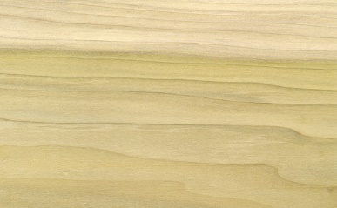
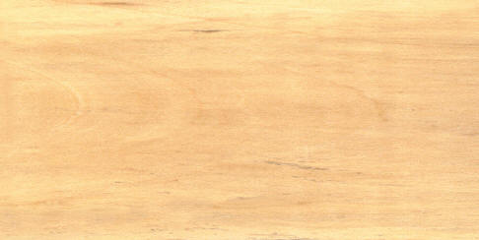
Requirement 2a
Ash
Ash is used for furniture, flooring, doors, cabinetry, architectural moulding and millwork, tool handles, baseball bats, hockey sticks, oars, turnings, and is also sliced for veneer. It is a popular species for food containers due to the wood having no taste.
Yellow Poplar
It becomes construction lumber; moldings, plywood cores, drawer sides, matches, piano and organ actions, containers, paper, woodenware, furniture parts, and even caskets.
Basswood
Carvings, lumber, musical instruments (electric guitar bodies), veneer, plywood, and wood pulp and fiber products.

Slide 22
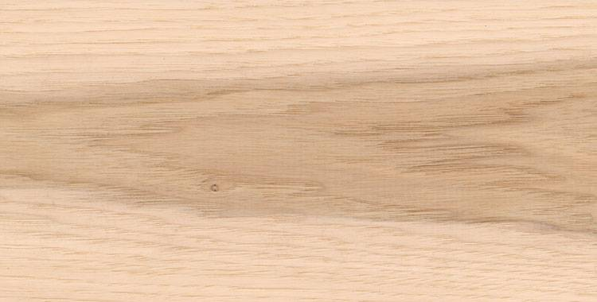
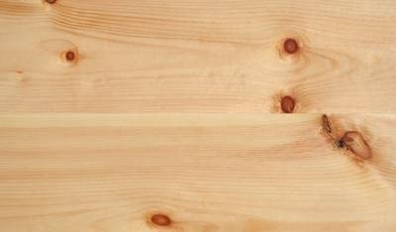
Requirement 2a
Hickory
Hickory wood is currently used to make home decor, such as flooring, cabinetry, and furniture, as well as tool handles (hammers, picks axes, etc.), sporting goods equipment, and industrial applications.
Pine
Pine wood is widely used in high-value carpentry items such as furniture, window frames, panelling, floors, and roofing, and the resin of some species is an important source of turpentine.

Slide 23
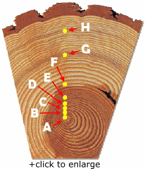
Requirement 2b
A
1920
The tree a loblolly pine is born.
(The tiny ring at letter “A” in the tree ring section above shows us how small the seedling was when it started to grow.)

Slide 24
Requirement 2b
B
1925
The tree grows rapidly with no disturbance. There is abundant rainfall and sunshine in spring and summer. The rings are relatively broad, and are evenly spaced.

Slide 25
Requirement 2b
C
1930
When the tree was 6 years old, something pushed against it, making it lean. The rings are now wider on the lower side as the tree builds “reaction wood” to help support it.

Slide 26
Requirement 2b
D
1940
The tree is growing straight again. But its neighbors are growing too, and their crowns and root systems take much of the water and sunshine the tree needs.

Slide 27
Requirement 2b
E
1943
The surrounding trees are harvested. The larger trees are removed and there is once again ample nourishment and sunlight. The tree can now grow rapidly again.

Slide 28
Requirement 2b
F
1946
A fire sweeps through the forest. Fortunately, the tree is only scarred, and year by year, more and more of the scar is covered over by newly formed wood. (Locate the black fire scar to the ring that is marked by the letter “F”.)

Slide 29
Requirement 2b
G
1958
These narrow rings (at letter “G” on the tree ring above) may have been caused by a prolonged dry spell. One or two dry summers would not have dried the ground enough to slow the tree’s growth this much.

Slide 30
Requirement 2b
H
1973
Another series of narrow rings may have been caused by an insect like the larva of the sawfly. It eats the leaves and leafbuds of many kinds of coniferous trees.

Slide 31
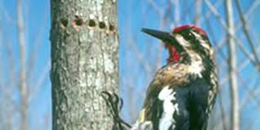
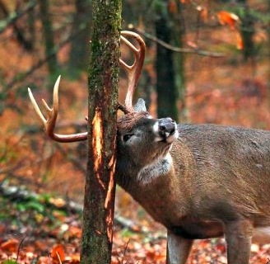
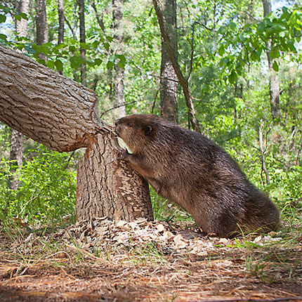
Requirement 2c
Animal Damage to Trees

Slide 32
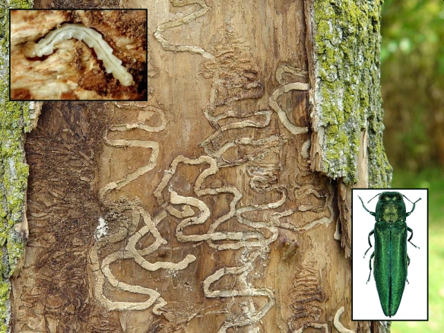
Requirement 2c
Insect Damage to Trees

Slide 33
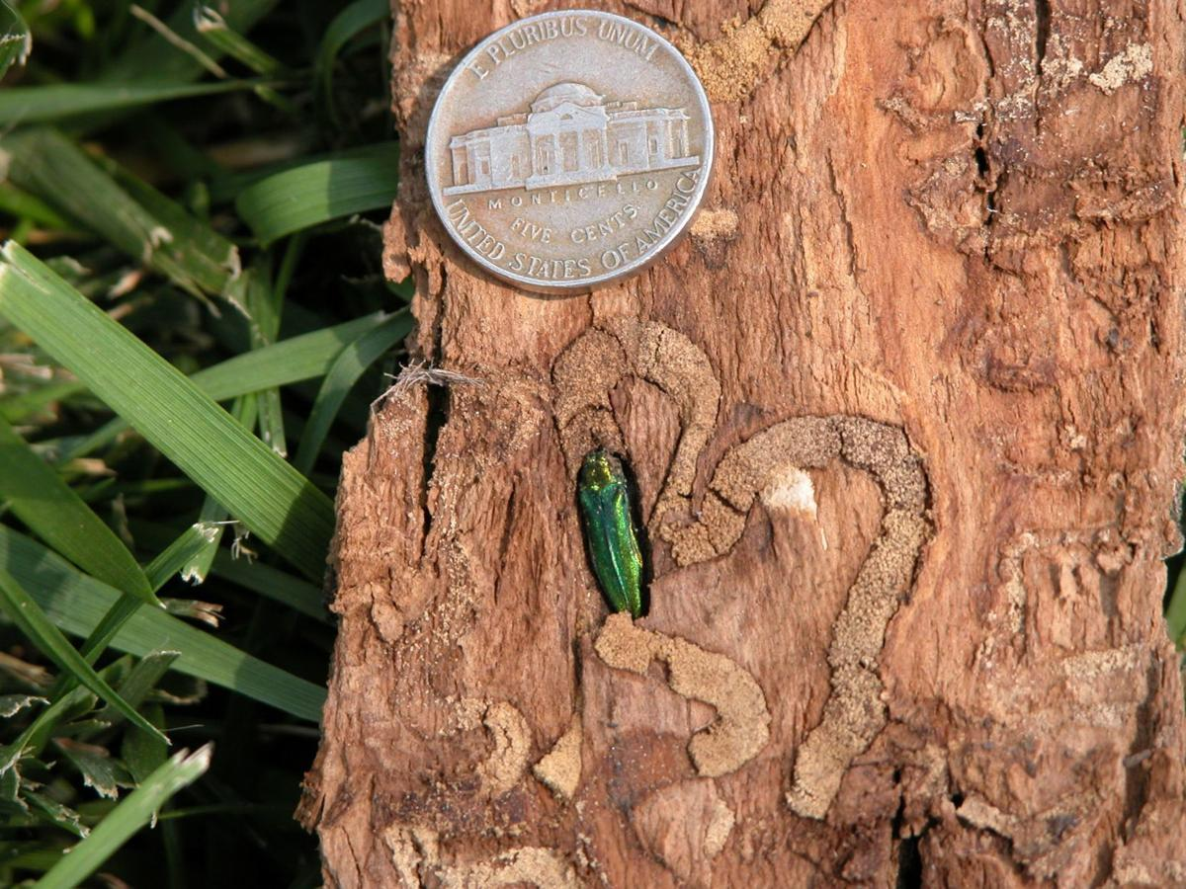
Insect Damage to Trees
Most insects attack only certain tree species or only trees of a certain age.
The larva of gypsy moths defoliate trees by eating many of the leaves.
The gypsy moth larvae attack hardwoods in the eastern states.
Fortunately, foresters that take quick action often are successful in stopping the spread of gypsy moths.
Emerald ash borers, introduced to the United States in shipping pallets coming from China, attack ash trees that have no natural defenses against them.
They cause extensive damage to ash trees by destroying their water-supply system.

Slide 34
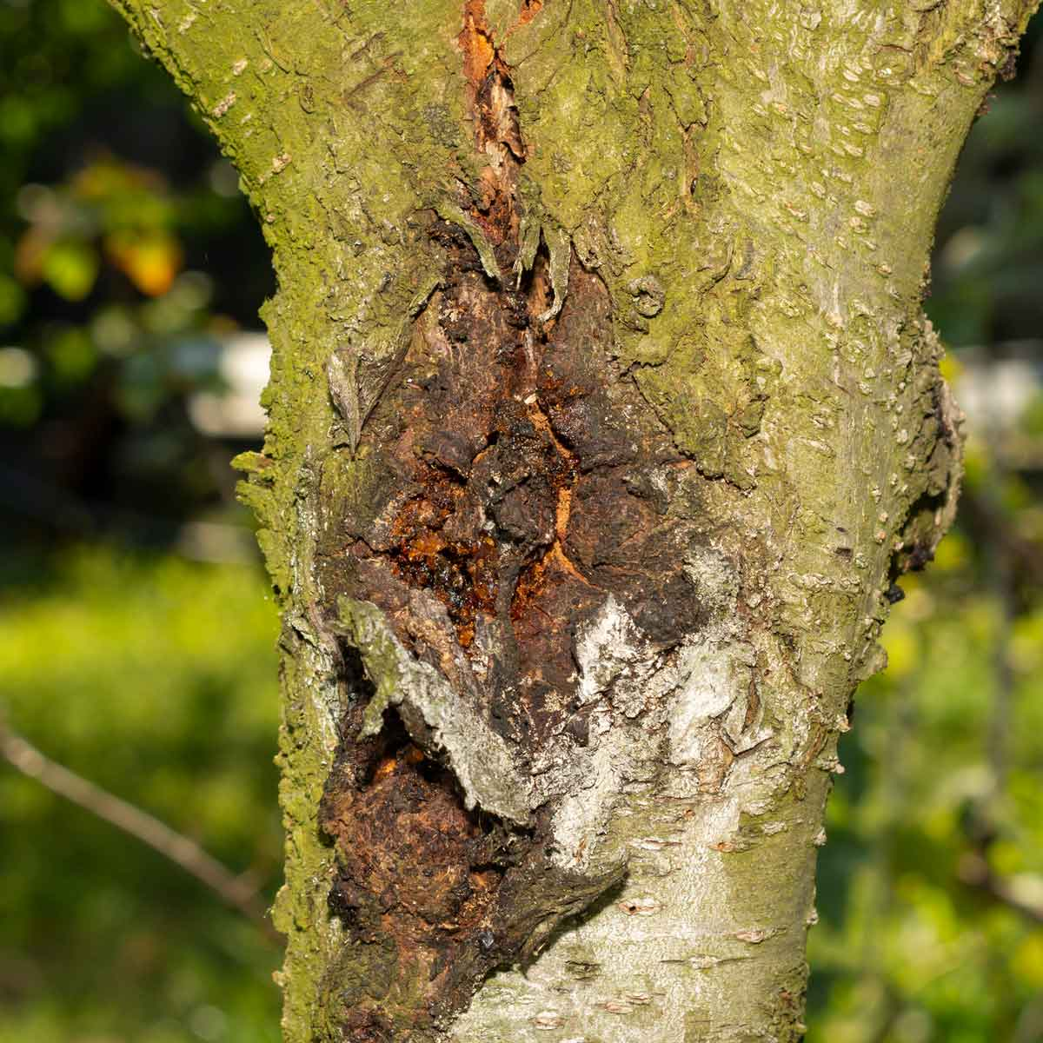
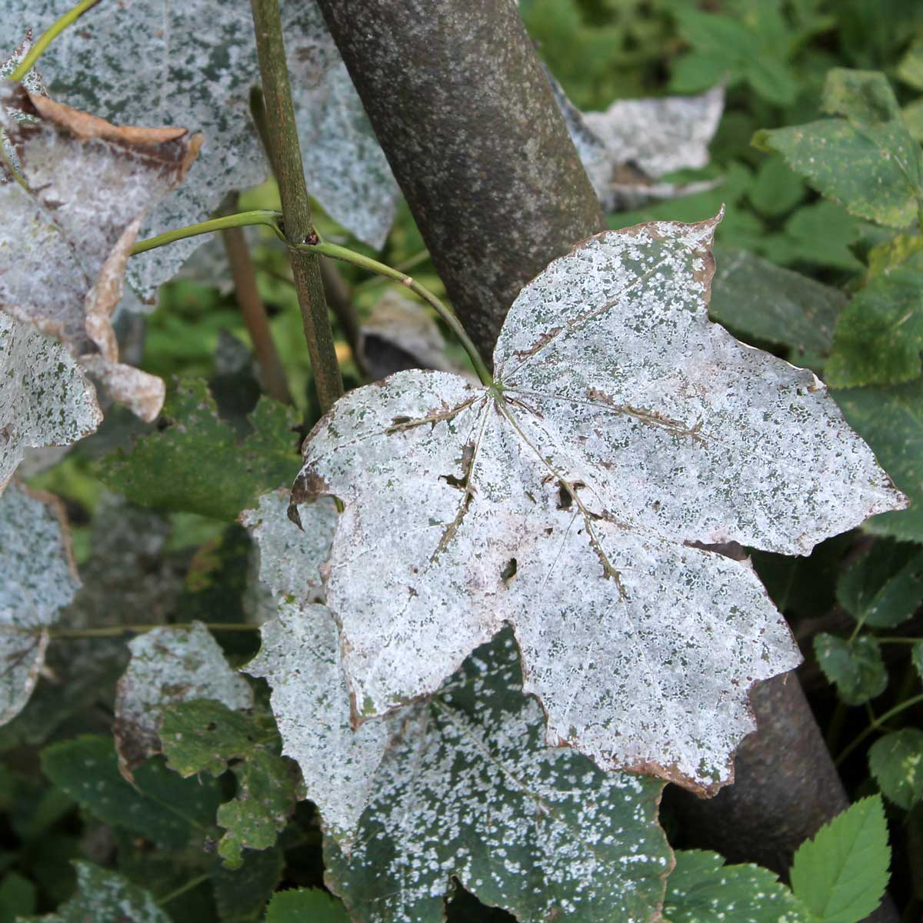
Requirement 2c
Disease Damage to Trees
Canker Tree Disease
Powdery Mildew

Slide 35
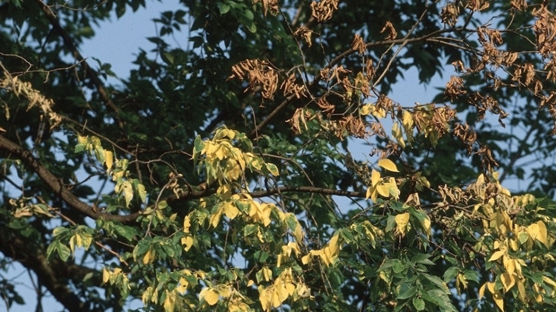
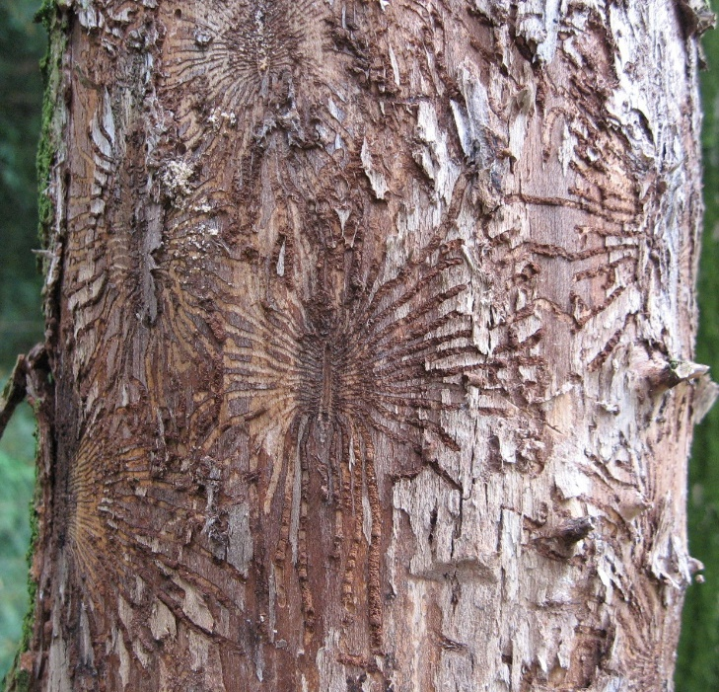
Disease Damage to Trees
Dutch Elm Disease is caused by a fungus carried from tree to tree by the elm bark beetle.
It clogs the vascular tissues within a tree preventing water movement to the crown.
It is one of the most devastating diseases ever to attack trees and led to the disappearance of most of the elms that once graced streets of U.S. cities and towns.

Slide 36
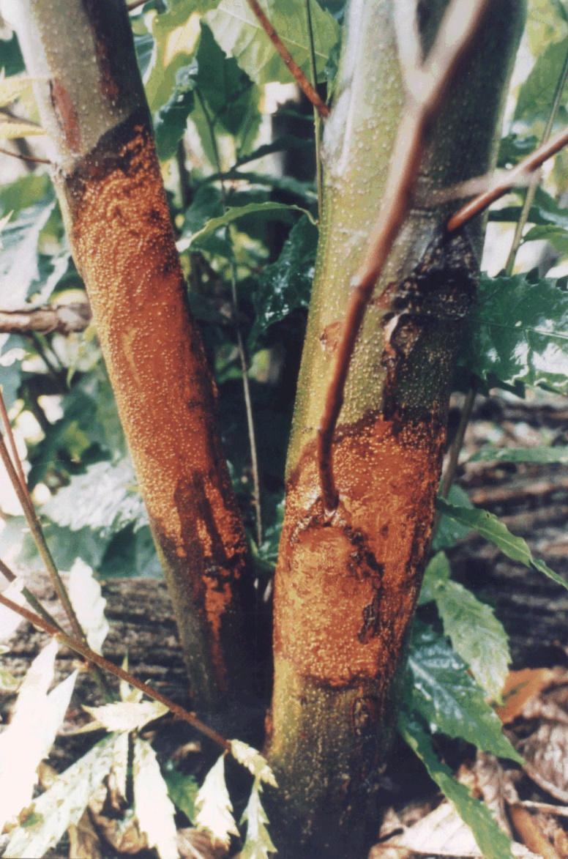
Disease Damage to Trees
Chestnut blight is caused by the pathogenic fungus (Cryphonectria parasitica) and was brought into the United States from Asia about 1900.
As it grows, the fungus essentially girdles the tree, cutting off its nutrient and water supply.
The blight destroyed nearly all the native chestnut trees in the United States.

Slide 37
Requirement 3
Do the following:
Describe contributions forests make to:
Our economy in the form of products.
Our social well-being, including recreation
Soil protection and increased fertility.
Clean water.
Clean air. (carbon cycling, sequestration)
Wildlife habitat
Fisheries habitat
Threatened and endangered species of plants and animals
Tell which watershed or other source your community relies on for its water supply.

Slide 38
Economy
Forests are recognized as an integral part of national economies, providing a wide range of goods, food, fuel, medicines, household equipment, building material and raw materials for industrial processing.
Forestry-related businesses support 2.9 million total jobs and are associated with $128.1 billion in total payroll.

Slide 39
Social Well-Being and Recreation
People have long enjoyed visiting forests.
Camping, hiking, picnicking, swimming, boating, and winter sports grow in popularity every year.
Outdoor recreation contributes greatly to the well-being of Americans – getting outside has been proven to have psychological, physical, social, as well as economic benefits.

Slide 40
Soil Protection and Fertility
Soil, a complex and variable medium made up of mineral particles, organic matter, water, air and living organisms, is one of the most important components of a forest ecosystem.
Soils provide the necessary foundation for trees and entire woodland ecosystems.
It helps regulate important ecosystem processes such as nutrient uptake, decomposition and water availability.
Trees and other plants play a vital role in the creation of new soil as leaves and other vegetation rot and decompose on the forest floor.
Forests help control or reduce soil erosion and the depletion of nutrients from healthy soil.
The interaction between forests and soil help to ensure that the soil is fertile enough for plant life to continue to grow and flourish and makes agricultural production possible.

Slide 41
Soil Protection and Fertility

Slide 42
Clean Water

Slide 43
Clean Air
Forests are among Earth’s great filters for removing carbon dioxide from the atmosphere and replenishing it with oxygen through photosynthesis.
Carbon dioxide is one of the most harmful greenhouse gasses, and filtering carbon dioxide out of the air is what trees do best.
Forests also improve public health greatly by catching dust, ash, pollen and smoke on their leaves, keeping it out of our lungs.
Trees are sinks for other harmful pollutants, such as nitrogen oxides, ammonia and ozone, which can all cause respiratory problems from repeated exposure.

Slide 44
Clean Air

Slide 45
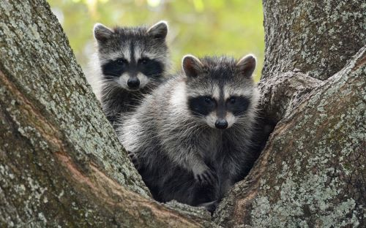
Wildlife Habitat
Forests are home to a tremendous range of animals, including large forest animals such as bear, deer, and elk and smaller creatures including birds, squirrels, salamanders, frogs, and fish.
These animals inhabit the forest; that is, they use it as a home.
The four essentials for an animal’s habitat—the area where a particular species prefers to live—are food, water, space, and shelter.
Through careful management, foresters can help the woods provide habitat for a large number of wildlife species in the same forest.

Slide 46
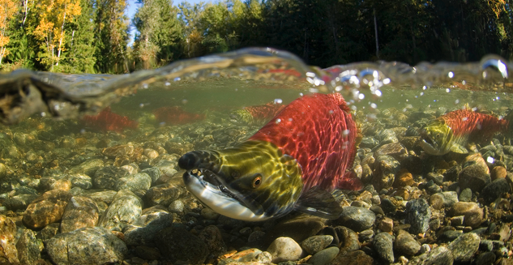
Fisheries Habitat
Forests can be critical to the survival of fish.
Trees and shrubs shade streams, keeping water at a temperature inviting to fish.
Insects that make their homes in streamside vegetation provide food for fish.
Leaves, branches, and other vegetation that drop into the water form pools and other places for aquatic life to rest, feed, hide, and spawn.
Forest managers make provisions to protect water quality and fisheries habitat in forests.

Slide 47
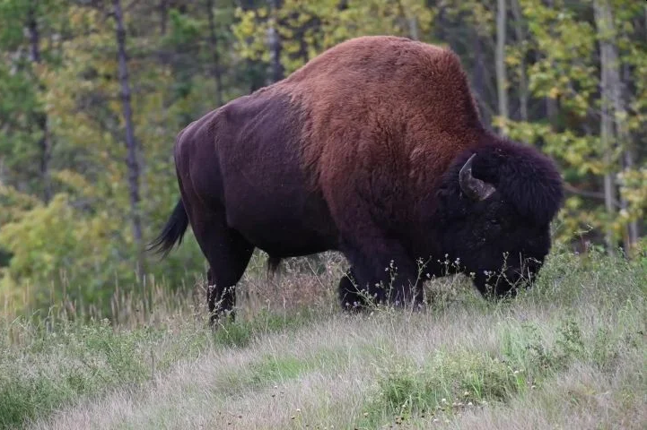
Threatened and Endangered Species
Naturally occurring changes that affect forest ecosystems often play important roles in maintaining a healthy balance of species populations.
Disruptions of forest ecosystems caused by humans have resulted in some animals and plants becoming so reduced in number that their very survival is endangered.
Laws today help protect many of these threatened and endangered species.
Generations of Americans have also had the wisdom to set aside tracts of unspoiled forest, protecting them in the forms of parks, wilderness areas, and wildlife refuges.
Managed forests play an important role in providing habitat for threatened and endangered species.
The protection of endangered species is important for maintaining a rich ecosystem diversity.

Slide 48
Watersheds and Water Supply
A watershed is an area of land that drains into a water body, whether it be river, lake, or ocean.
There are different watersheds that cover Ohio.
Every inch of Ohio, however, is covered by the Lake Erie Watershed or the Ohio River Watershed.

Slide 49
Maumee River Watershed
The Maumee River Watershed is part of the Lake Erie watershed, but it is also possible to live in an even smaller watershed that joins into the Maumee Watershed.

Slide 50
Sandusky River Watershed

Slide 51
Toussaint and Portage River Watershed

Slide 52
Requirement 4
Describe what forest management means, including the following:
Multiple-use management
Sustainable forest management
Even-aged and uneven-aged management and silvicultural systems associated with each type.
Intermediate cuttings.
The role of prescribed burning and related forest management practices.

Slide 53
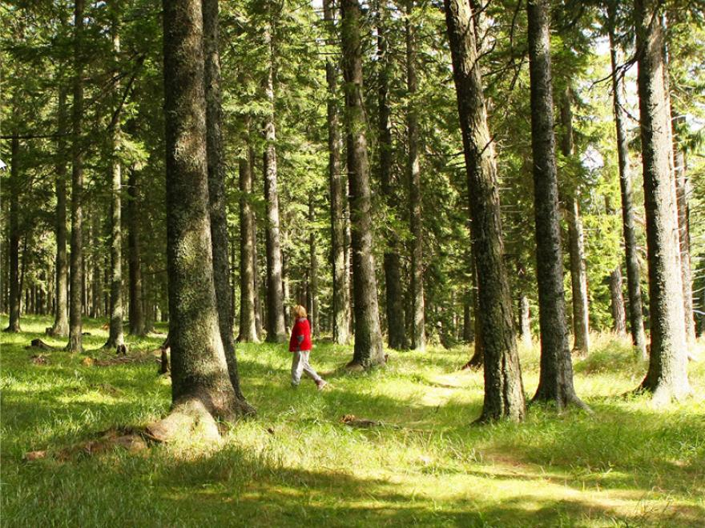
Forest Management
Forest management is for maintaining and improving the health, diversity, and productivity of forests to meet the needs of current and future generations.
Forest management focuses on:
managing vegetation,
restoring ecosystems,
reducing hazards, and
maintaining forest health.

Slide 54
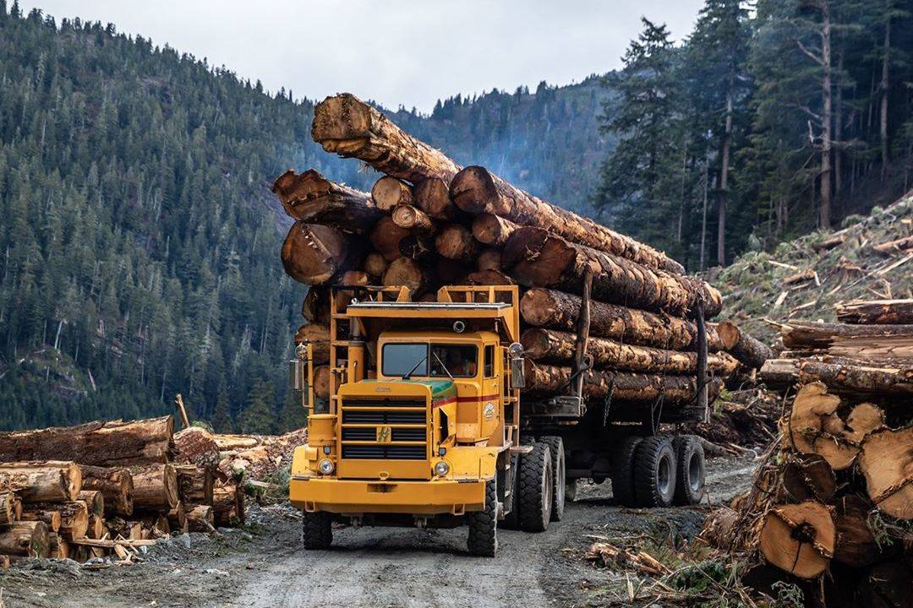
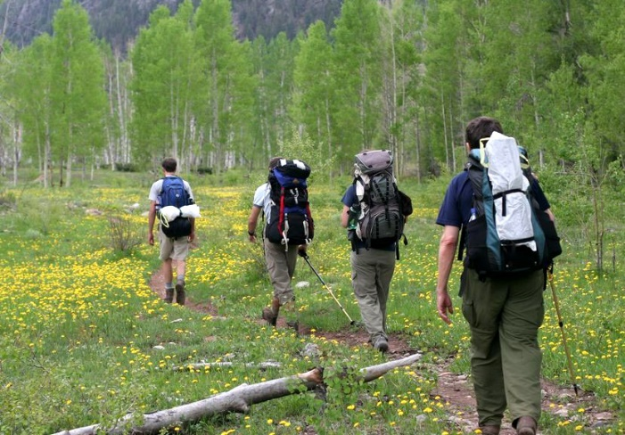
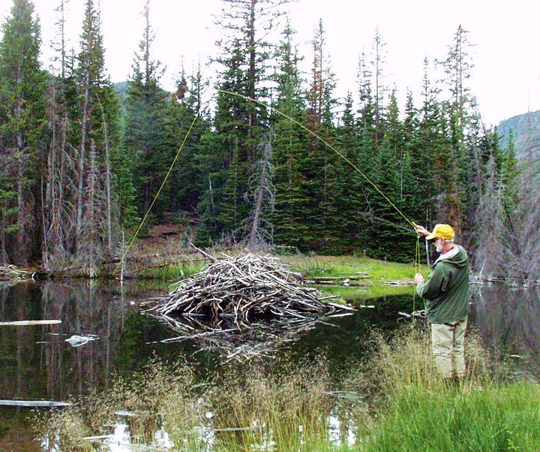
Multiple Use Management
Multiple-use management addresses the desires of a broad range of forest users.
Harvesting, recreation, wildlife, and other interests are all considered in multiple-use forest plans.

Slide 55
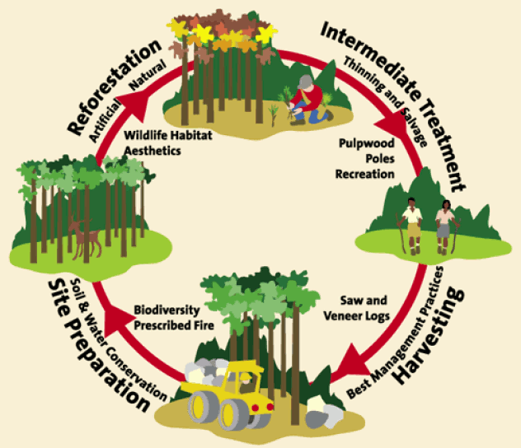
Sustainable Forest Management
Sustainable forest management takes forest planning a step further by emphasizing the importance of considering the needs of today’s forest users while also ensuring that future generations will be able to enjoy healthy forests.
Sustainable management views forests as sources of raw materials and recreation, but it also involves stewardship that gives full attention to caring for wildlife habitat, increasing the diversity of species, and protecting the quality of the air, water, and soil.

Slide 56
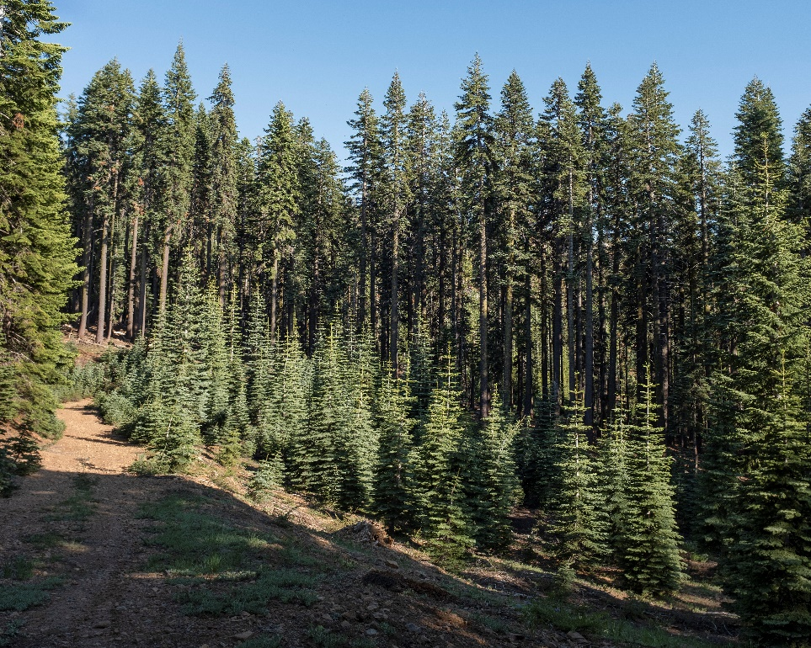
Even-Aged Management
Systems that result in trees of approximately the same age are called even-aged systems.
There are three classic even-aged silvicultural systems:
Clear-cut
Seed-tree
Shelterwood

Slide 57
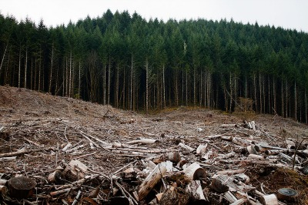
Clear-Cut System
In the clear-cut system, all the trees in a unit are harvested in one operation, and the area usually is reforested by planting, unless abundant natural seeding is expected.
Units can vary in size and shape, but generally harvesting anything larger than a group selection (one to three acres, depending on the size of the dominant trees for the site) can be called a clear-cut system.

Slide 58
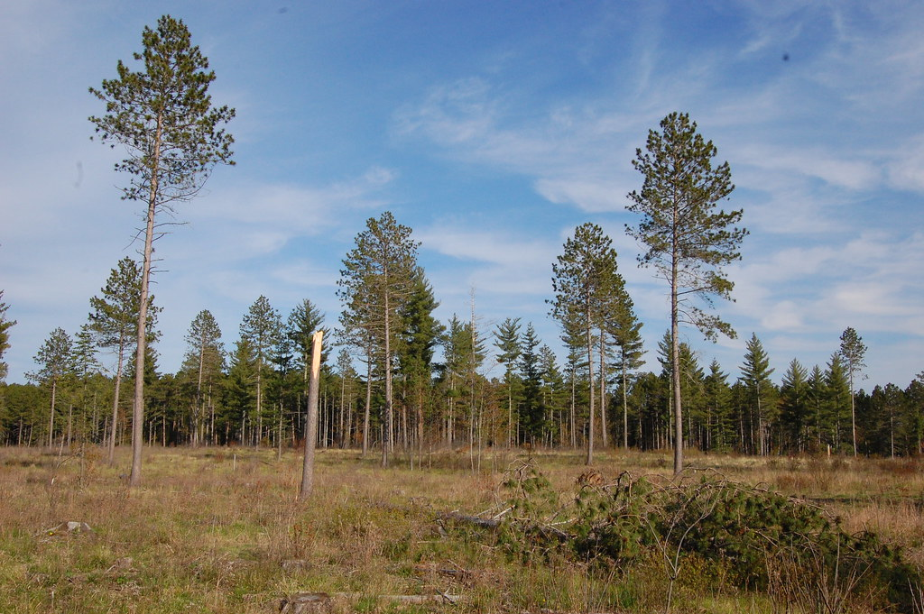
Seed-Tree System
The seed-tree system is like a clear-cut system, except that five to ten trees per acre are left evenly distributed across the site to produce tree seed.
The seed trees are usually harvested after new seedlings are established.

Slide 59
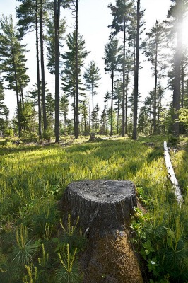
Shelterwood System
The shelterwood system is similar to the seed-tree system, except that more trees are left to shelter the site on which new seedlings will be regenerating.
This system is commonly used on hot, dry sites and where aesthetic qualities are critical.
Shelterwood harvests may be made in two or three entries, with small trees removed in one harvest, more trees removed in a second “seed cut,” and seed trees removed in a third harvest after new seedlings are established.
In some regions of the United States, shelterwood cuts are commonly done in two cuts, like with the seed-tree method but with more trees left to provide seed before the final harvest.

Slide 60
Uneven-Aged Management
Systems that result in trees of many ages are termed uneven-aged systems.
The selection method is method used to re-generate uneven-aged forests.
There are two variations of the selection method:
Single tree
Group selection.

Slide 61
Single Tree Selection Method
With this method, single mature trees are harvested from the forest.
Harvesting mature trees in a forest will create vacancies within the upper tree crown level.
These vacancies will cause the surrounding trees to grow faster and these trees will eventually fill the crown void.
New seedlings established in the opening will be exposed to shade.
Only trees which survive in the shade will grow and develop under these conditions.

Slide 62
Group Selection Method
In the group selection method, trees are harvested in small groups.
The larger openings will have conditions, at least near the center of the opening, that are most suitable for regeneration of trees needing full sunlight.

Slide 63
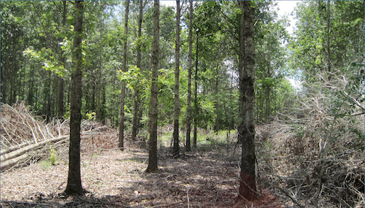
Intermediate Cuttings
A tree needs a place in the sun, soil of its own, and room to expand if it is to thrive.
When a stand of trees is too dense, a professional forester may prescribe thinning to ease the competition and to accelerate growth of the trees that remain.
The trees that are removed might be sold as posts, poles, or pulpwood (for use in making paper).
If they are too small to have market value, the thinning is called precommercial.
These trees are cut and left to decay, returning nutrients to the soil.

Slide 64
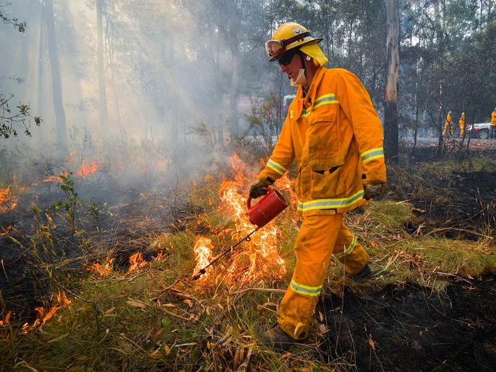
Prescribed Burning
To lessen the danger of devastating fires, foresters might intentionally set fire to an area.
This prescribed burning is carefully planned, and the fire is set according to a prescription written for the conditions that exist and the objectives to be achieved.
The fire exposes the soil, releases nutrients into the soil, eliminates some insects and diseases, and removes undesirable trees or brush.
The heat also can open up fallen cones.
Prescribed burns made on a regular basis—every three to five years, for example—can reduce dried leaves and brush that, if allowed to accumulate, could eventually feed a very damaging wildfire.
Wildfires are uncontrolled fires, and they can be avoided or made less severe by prescribed burning.

Slide 65
Requirement 5
With your parent's and counselor's approval, do ONE of the following:
Visit a managed public or private forest area with its manager or a forester familiar with it. Write a brief report describing the type of forest, the management objectives, and the forestry techniques used to achieve the objectives.
Take a trip to a logging operation or wood-using industrial plant and write a brief report describing:
The species and size of trees being harvested or used and the location of the harvest area or manufacturer.
The origin of the forest or stands of trees being utilized (e.g., planted or natural)
The forest's successional stage. What is its future?
Where the trees are coming from (land ownership) or where they are going (type of mill or processing plant)
The products that are made from the trees
How the products are made and used.
How waste materials from the logging operation or manufacturing plant are disposed of or utilized.
Take part in a forest-fire prevention campaign in cooperation with your local fire warden, state wildfire agency, forester, or counselor. Write a brief report describing the campaign, how it will help prevent wildfires, and your part in it.

Slide 66
Requirement 5a
Maps of State Forests in Ohio
Contact Information for Ohio Department of Natural Resources (ODNR) – Division of Forestry

Slide 67
Requirement 6
In your camp, local recreation area (park or equivalent), or neighborhood, inventory the trees that may be a hazard to structures or people. Make a list by area (campsite, road, trail, street, etc.). Note the species and hazardous condition, and suggest a remedy (removal or trimming). Make your list available to the proper authority or agency.

Slide 68
Tree Dangers
Trees provide significant benefits to our homes and cities, but when trees fall and injure people or damage property, they are liabilities.
Understanding and addressing the risks associated with trees makes everybody safer and prolongs the life of the tree.

Slide 69
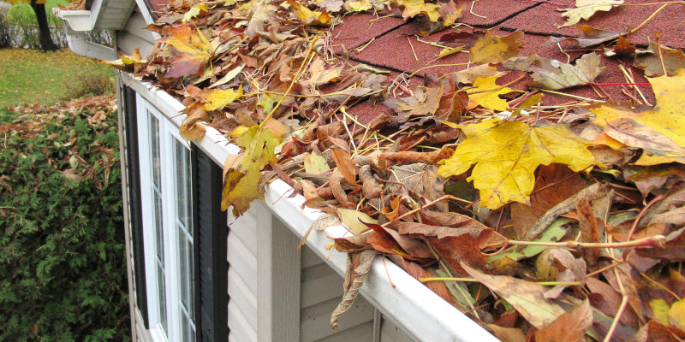
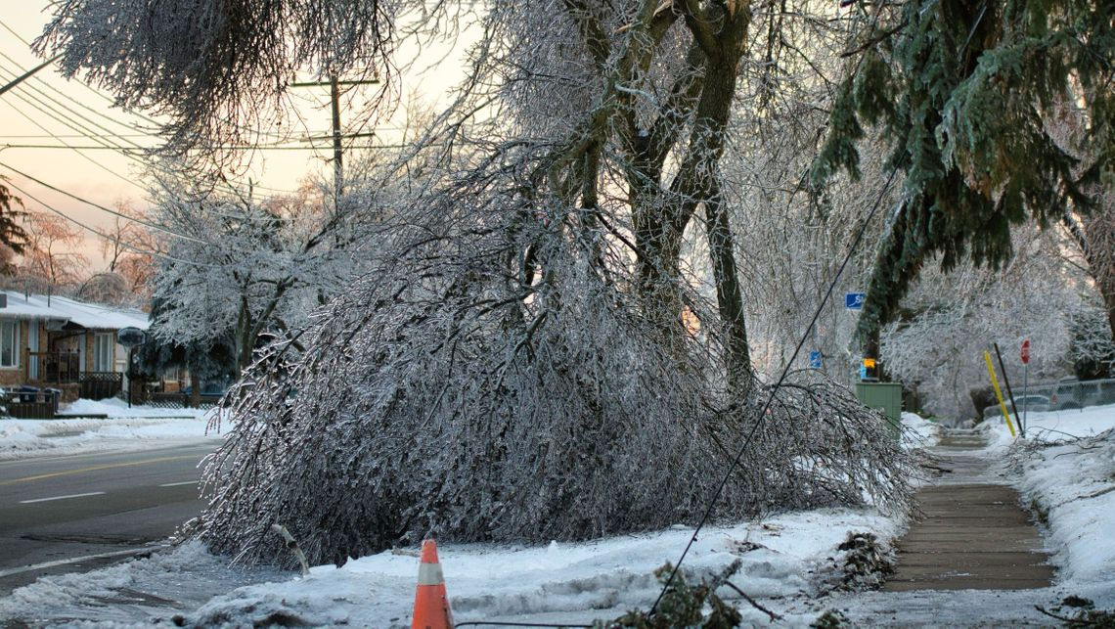
Tree Dangers
Trees that are too close to buildings may be fire hazards. Soffit vents provide easy access for flames to enter a house.
Leaves and broken branches can clog gutters, potentially causing ice dams or water penetration into the building.
Old, damaged or otherwise weak trees may fall and endanger lives and property. Large, weak branches, too, are a hazard, especially if weighed down by ice.

Slide 70
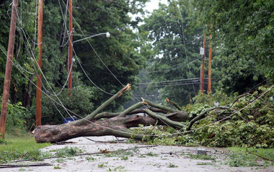
Tree Dangers
Tree roots can potentially penetrate underground drainage pipes, especially when they leak. Water that leaks from a drainage or sanitary pipe can encourage root growth in the direction of the leak, where the roots may eventually enter the pipe and obstruct its flow.
Trees may be used by insects and rodents to gain access to the building.
Falling trees and branches can topple power lines and communication lines.

Slide 71
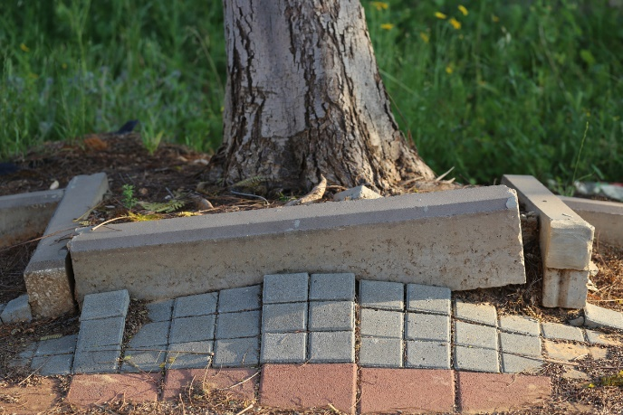
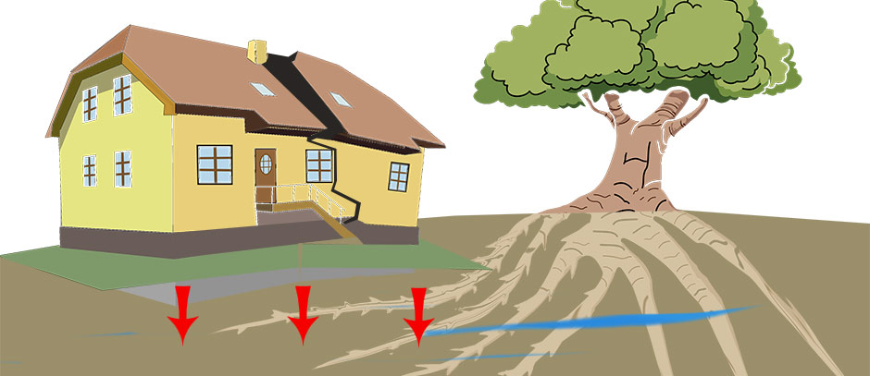
Tree Roots and Foundations
Roots can sometimes penetrate a building's foundation through pre-existing cracks.
Large root systems that extend beneath a house can cause foundation uplift.
Roots can leech water from the soil beneath foundations, causing the structures to settle and sink unevenly.

Slide 72
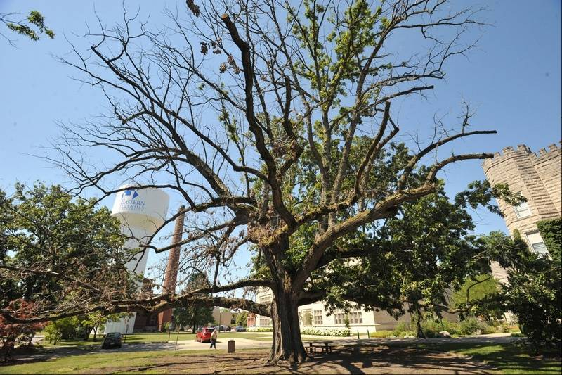
Structural Defects in Trees
Trees with structural defects likely to cause failure to all or part of a tree can damage nearby buildings. The following are indications that a tree has a structural defect:
dead twigs, dead branches, or small, off-color leaves;
hollowed trunks;

Slide 73
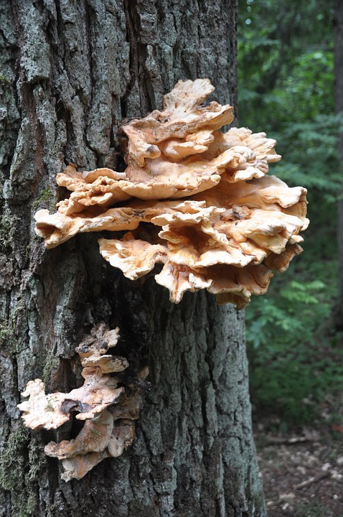
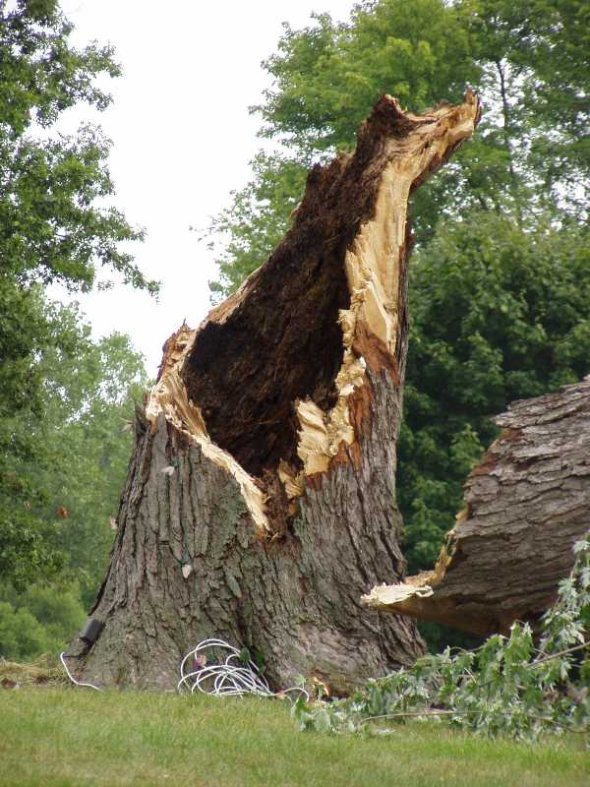
Structural Defects in Trees
Structural defects (continued):
Advanced decay (wood that is soft, punky or crumbly, or a cavity where the wood is missing) can create a serious hazard. Evidence of fungal activity, such as mushrooms, conks and brackets growing on root flares, stems or branches are indications of advanced decay. A tree usually decays from the inside out.

Slide 74
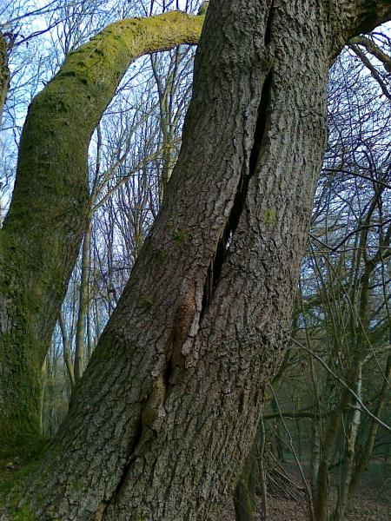
Structural Defects in Trees
Structural defects (continued):
cracks, which are deep splits through the bark, extending into the wood of the tree. Cracks are very dangerous because they indicate that the tree is presently failing.
V-shaped forks. Elm, oak, maple, yellow poplar and willow are especially prone to breakage at weak forks.
The tree leans at more than 15 degrees from vertical.

Slide 75
Tips for Reducing Tree Dangers
When planting trees, they should be kept far from the house. It is impossible to reliably predict how far the roots will spread, and trees that are too close to a building may be a fire hazard.
Do not damage roots. In addition to providing nutrition for the tree, roots anchor the tree to the ground. Trees with damaged roots are more likely to lean and topple than trees with healthy roots. Vehicles are capable of damaging a tree's root system.

Slide 76
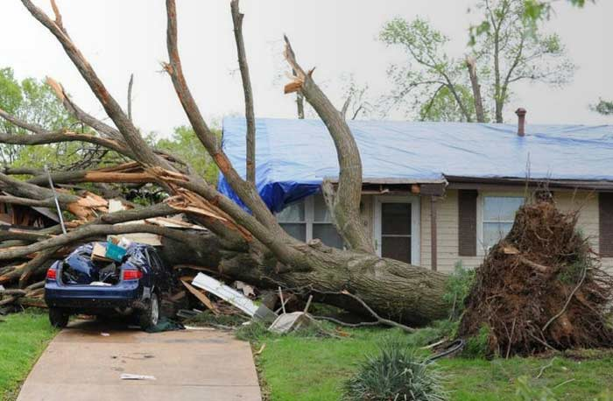
Tips for Reducing Tree Dangers
Inspect your trees periodically for hazards, especially in large, old trees. Every tree likely to have a problem should be inspected from bottom to top. Look for signs of decay and continue up the trunk toward the crown, noting anything that might indicate a potential hazard.
Binoculars are helpful for examining the higher portions of tall trees for damage.
Dead trees within the range of a house should be removed. If they are not removed, the small twigs will fall first, followed by the larger branches, and eventually the trunk.

Slide 77
Requirement 7
Do the following:
Describe the consequences to forests that result from FIVE of the following elements: wildfire, absence of fire, destructive insects, loss of pollinating insect population, tree diseases, air pollution, overgrazing, deer or other wildlife overpopulation, improper harvest, and urbanization.
Explain what can be done to reduce the consequences you discussed in 7a.
Describe what you should do if you discover a forest fire and how a professional firefighting crew might control it. Name your state or local wildfire control agency.

Slide 78
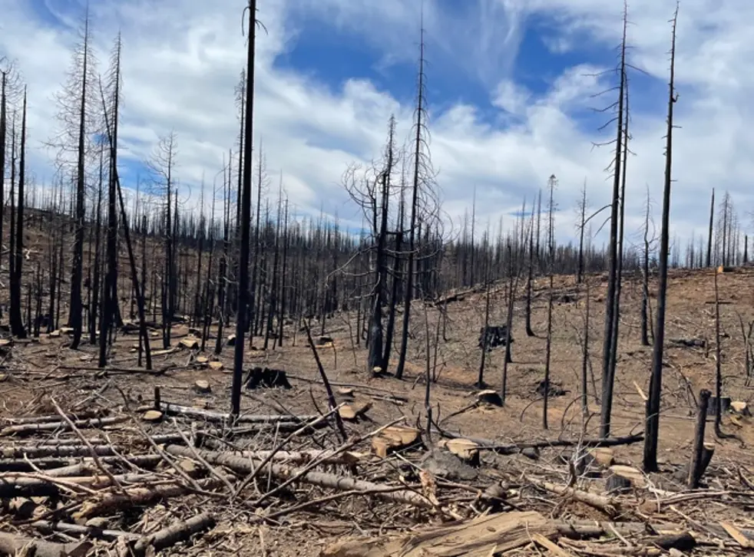
Wildfire Consequences
Wildfires can leave great scars on the countryside by destroying trees, brush, grass, and even the fertile top layers of the soil.
Wildfires can destroy the ground litter, which acts as a protective soil covering.
Intense fires can change the composition of soil, causing it to repel water.
Water rapidly runs off this soil into streams and reservoirs and may cause floods. It also washes sediment, ashes, and debris from the burned areas into watersheds.

Slide 79
Wildfire Remediation
Prescribed Fire
To lessen the danger of devastating fires, foresters might intentionally set fire to an area. This prescribed burning is carefully planned, and the fire is set according to a prescription written for the conditions that exist and the objectives to be achieved.
The fire exposes the soil, releases nutrients into the soil, eliminates some insects and diseases, and removes undesirable trees or brush.
The heat also can open up fallen cones.
Prescribed burns made on a regular basis—every three to five years, for example—can reduce dried leaves and brush that, if allowed to accumulate, could eventually feed a very damaging wildfire.
Wildfires are uncontrolled fires, and they can be avoided or made less severe by prescribed burning.

Slide 80
Prescribed Burn

Slide 81
Absence of Fire Consequences
Much modern concern about fires results from past management practices that sought to eliminate all fires.
That approach often allowed deadwood to build up on forest floors.
When a fire does break out and burns into that deadwood, it may be hotter and more destructive than if the natural cycles of fire and regeneration had been allowed to play themselves out.

Slide 82
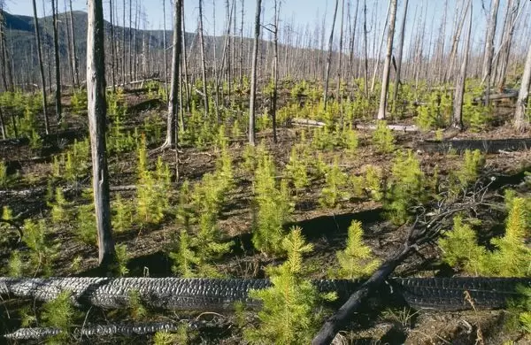
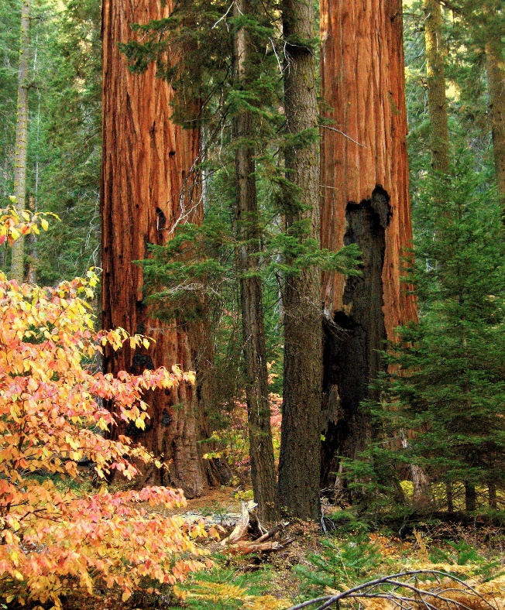
Absence of Fire Remediation
Surface fires caused by lightning have a natural role to play in many forests by consuming much of the brush and deadwood choking a forest’s understory, releasing nutrients into the soil, and providing a fertile bed for new growth.
Fire exposes soil so that seeds may germinate, releases seeds from cones or hard seed covers, removes the thatch layer that shades small-statured species, and plays many other ecological roles.
Mature trees can often withstand the heat of occasional fires, because their bark is dense enough to prevent them from being seriously damaged.

Slide 83
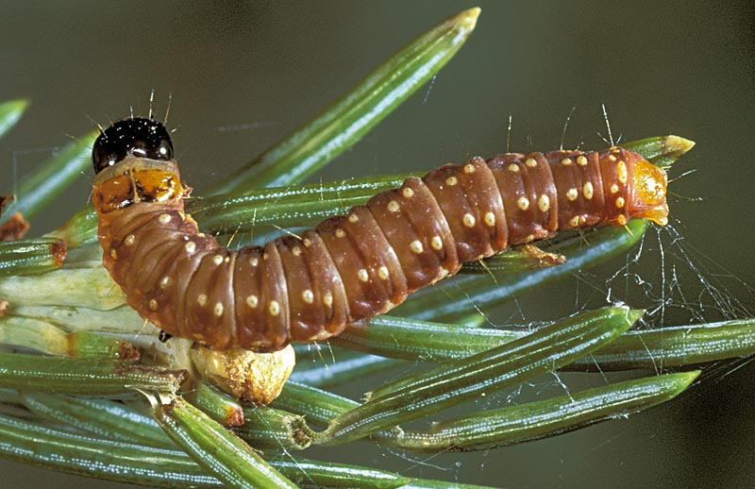
Destructive Insects Consequences
Insects such as the spruce budworm and larvae of the gypsy moth defoliate trees by eating many of the leaves.
The spruce budworm damages spruce and fir forests throughout New England, eastern Canada, and Minnesota.
In the West, they have weakened some forests and left them open to catastrophic wildfires.
The gypsy moth larvae attack hardwoods in the eastern states.
Spruce Budworm

Slide 84
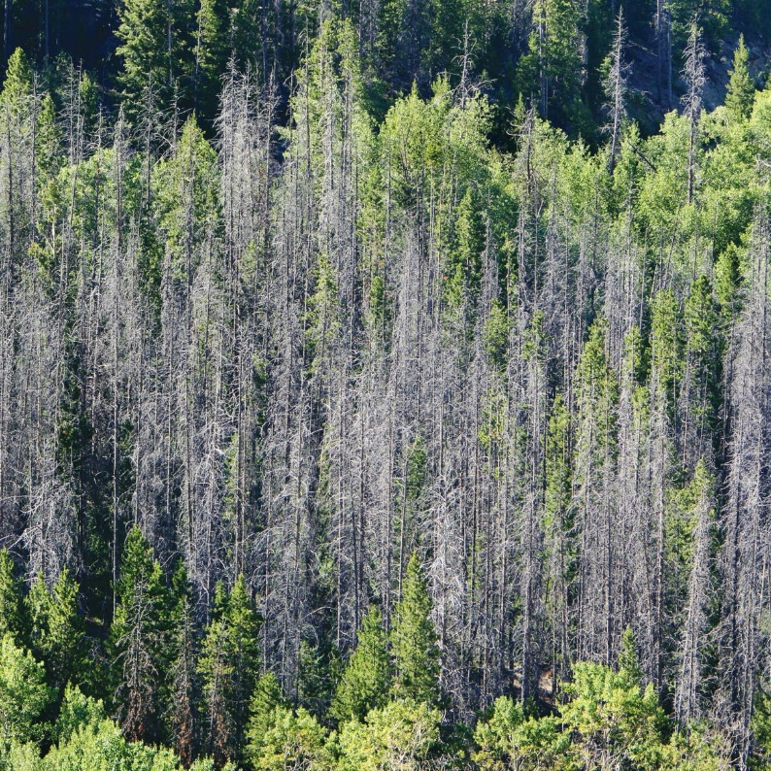
Destructive Insects Consequences
Epidemics of bark beetles periodically kill tens of thousands of acres of pine in the Southern, Southwestern, and Rocky Mountain regions of the United States.
These pests generally attack mature trees.

Slide 85
Destructive Insects Consequences
The pinecone beetle can destroy almost the entire yearly seed crop of some western pines.
Emerald ash borers, introduced to the United States in shipping pallets coming from China, attack ash trees that have no natural defenses against them.

Slide 86
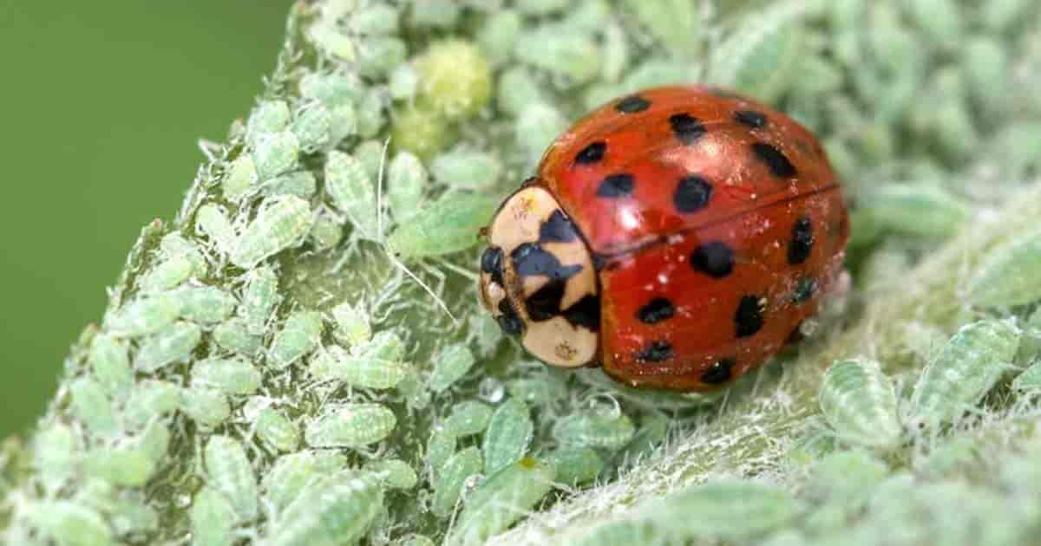
Destructive Insects Remediation
In commercial forests where trees are raised as a crop, insect infestations are sometimes suppressed with pesticides (chemicals for controlling insects and disease).
Forest researchers continue to search for alternative methods of minimizing insects and disease outbreaks.
For example, artificial scents can be used to confuse the mating habits of certain insects and thus reduce their numbers.
In some forests, scientists promote the populations of insects that feed on disease-bearing insects.
Ladybug feeding on aphids

Slide 87
Loss of Pollinators Consequences
Pollinators rely on forests for their homes and food, while many plants within forests depend on the services of pollinators for reproduction and disease and insect resistance through genetic diversity.
Without them, humans and wildlife wouldn't have much to eat or look at!

Slide 88
Loss of Pollinators Remediation
Within forests themselves, practices that help maintain healthy pollinator populations include regulating grazing in forests to minimize competition for flowers, retaining dead standing and lying wood for nesting, and conducting selective logging, burning, mowing, and thinning.
Selective thinning has been shown to increase flowering, leading to a greater abundance of pollinators.

Slide 89
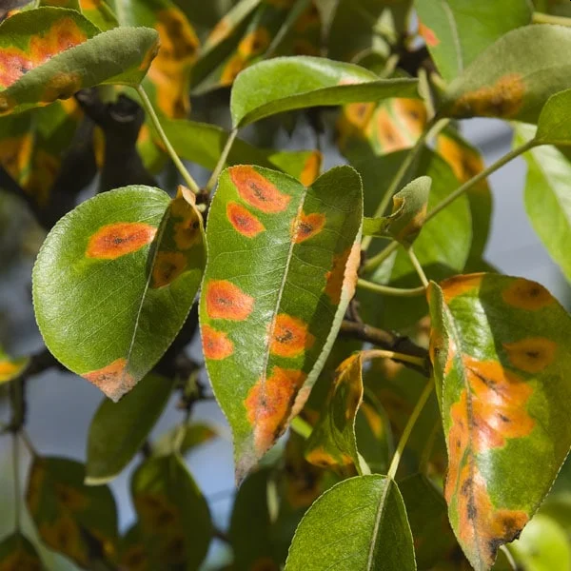
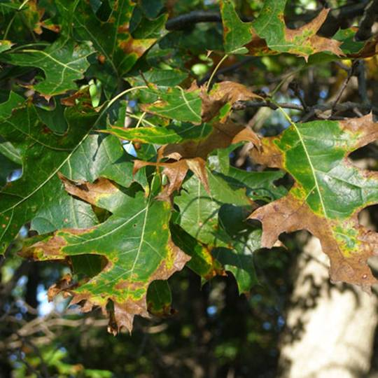
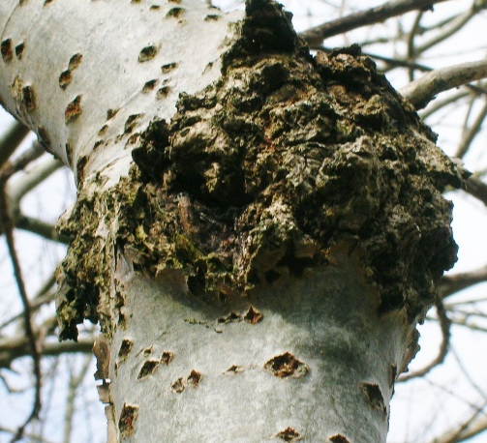
Tree Diseases Consequences
Leaf spot disease
Rust disease
Oak wilt disease
Canker tree disease
Trees are also subject to many diseases:
Leaf spots, rusts, wilts, blights, and cankers can weaken or kill forest trees.
Many diseases with the potential of damaging trees in the United States and Canada are native to the forests they inhabit.
Because they are a part of the forest ecology and have a niche, they often can be controlled through adjustments of their habitat.

Slide 90
Tree Diseases Consequences
Diseases brought to North America from other parts of the world, such as the Dutch elm disease and Chestnut blight can pose more serious problems because they have no natural controls.
Early symptom of Dutch elm disease is wilting of upper branches of an infected elm.
Chestnut blight

Slide 91
Tree Diseases Remediation
A healthy forest with many diverse species of plants and animals can withstand attacks of diseases better.
Not all trees are as susceptible to certain diseases as others, so one way in which we can look to combat rising outbreaks is to breed and plant resistant trees.
In some forests, scientists promote the populations of insects that feed on disease-bearing insects.

Slide 92
Air Pollution Consequences
Air pollution directly injures trees by damaging living tissue.
Air pollutants also weaken trees, predisposing them to further damage by insects and disease.
The result is decreased tree vigor and growth that can culminate in tree death.

Slide 93
Air Pollution Remediation
The most serious forms of air pollution are difficult to prevent without a community effort.
Minimize the air pollution you produce by keeping your automobiles tuned, limiting your use of internal combustion engines and obeying local open-burning ordinances.
Planting more trees can also help. When planting new trees, consider planting trees that are more tolerant of common air pollutants.

Slide 94
Wildlife Overpopulation Consequences
The overpopulation of deer throughout areas of the United States is destroying the forest and hindering the diversity of tree species. Deer put the forests in danger of becoming pastureland because overpopulated deer consume young trees.
Indirect effects on wildlife have been reported as well. One study found forest songbirds that preferred nesting in the shrub and intermediate canopy layer declined in abundance and species richness as deer density increased.
The forest understory is nearly absent. Note the deer appears to be especially thin.

Slide 95
Wildlife Overpopulation Remediation
Deer hunting is a practice employed to regulate the population of deer.
Birth control vaccines have been invented that will prevent doe from having fawns for up to 3 years.
These vaccines can be administered by dart or by a shot.
This type of management would be an alternative to hunting
Preparing to inject a white-tailed deer with a birth control vaccine.

Slide 96
Improper Harvest Consequences
Improper timber harvests can have devastating effects on the entire ecosystem.
Such effects include:
Increased sediment runoff into streams which affects fish reproduction and development.
Entire stands are replaced with monocultures of replanted trees which decrease wildlife habitat and can make stands more susceptible to disease and insects.
Increased stream flows and flooding due to loss of trees which uptake large amounts of water.
Logging operations themselves can have many devastating effects such mass soil erosion caused by poor road placement.

Slide 97
Improper Harvest Remediation
Sustainable harvest practices are those which take into consideration regeneration and the long-term well-being of the forest.
In a sustainable harvest either the best trees will be left standing until a new forest of younger, healthy trees begins to grow underneath it, or everything will be removed so there is no vegetation left to compete with the young sprouts and seedlings.
In the second type of harvest mentioned (a silvicultural clearcut) new trees can be planted in this open area, or the healthiest young growth (the seeds and sprouts already on the ground) will be able to outcompete the weaker individuals, and the forest will begin to form itself into a healthy future stand.

Slide 98
Urbanization Consequences
As urbanized areas expand, they are encroaching on preserved areas, like national wildlife refuges, and are dividing forests into smaller fragments.
Fragmentation leads to loss of biodiversity, increases in invasive plants, insect pests, and pathogens, and reduction in water quality.
Forests that are located next to cities and suburbs are exposed to higher temperatures, pollution, and other factors that threaten forest health.
Urbanization also alters forest ecosystems by disrupting nutrient cycling.

Slide 99
Urbanization Remediation
Maintaining and planting urban trees can help to lessen some of the negative impacts of urbanization by:
Increasing urban biodiversity by providing plants and animals with habitat, food and protection.
Improve air quality in cities with high levels of pollution making cities healthier places to live in.
Cooling the air and reducing the urban “heat island” effect.
Filtering urban pollutants and fine particulates.
Reducing carbon emissions by helping to conserve energy. The correct placement of trees around buildings can reduce the need for air conditioning and reduce winter heating bills.

Slide 100
If You Discover a Forest Fire…
If you discover a fire, do not put yourself in danger.
Warn others that might be in danger.
Move to a safe location.
Alert rescue services by calling 911.
If possible, extinguish the fire.

Slide 101
How Forest Fires Are Controlled
Firefighters know that to control any fire, it must be stopped from spreading and then put out completely.
Trained firefighters will attack a forest fire in one or all of the following ways.
Remove the fuel supply. Using rakes, shovels, or heavy equipment, firefighters create a trench of bare earth around the fire.
Cut off the air to smother the fire. Firefighters working on the ground can throw dirt on the fire. Aircraft can spread chemical fire retardants on the flames.
Lower the heat. Fires near roads can be fought using water sprayed from fire trucks. A helicopter slinging a 200-gallon bucket from a cable is sometimes brought in to dump water on the flames of more remote fires.

Slide 102
Ohio Wildfire Control Agency
The Ohio Division of Forestry under the Ohio Department of Natural Resources trains folks in federal, state, and local agencies in wildland firefighting, as well as managed fires for forest regeneration.
Local fire fighting agencies are usually the first responders in a wildfire incident.

Slide 103
Requirement 8
Visit one or more local foresters and write a brief report about the person (or persons). Or, write about a forester's occupation including the education, qualifications, career opportunities, and duties related to forestry.

Slide 104
How to Become a Forester
Training
Most foresters have at least a bachelor’s degree in forestry.
Many have master’s and doctorate degrees.
Forestry students take biology and physical and social science classes.
Then comes intensive study of ecology, forest economics, forest protection, silviculture, resources management and use, dendrology (classification of trees), and forest measurement, policy, and administration.

Slide 105
How to Become a Forester
Salary
The average Forester salary in the United States is $71,873 as of January 27, 2022, but the range typically falls between $59,550 and $86,487.
Salary ranges can vary widely depending on many important factors, including education, certifications, additional skills, and the number of years you have spent in the profession.

Slide 106
Career Opportunities in Forestry
Federal Agencies.
The USDA Forest Service employs more foresters than the other federal branches.
They enforce the law, conduct timber inventories and boundary surveys; help control damage by fire, insects, and diseases; conduct reforestation, timber marking, log scaling, and range-forage surveys; assist with recreational development; and conduct research.

Slide 107
Career Opportunities in Forestry
State, County, and City Governments.
Being a forester for state government can include fire protection on public and private forests, management of publicly owned forests, management and marketing assistance to private landowners, conservation education, public relations, and implementation of state forest practice acts.
Urban foresters protect and improve the vegetation in and around populated areas.

Slide 108
Career Opportunities in Forestry
Private Industry.
Industrial foresters work for corporations.
They plan and direct tree planting, determine timber-harvesting schedules, supervise operations, and help protect the timber from fire, insects, disease, and theft.
They must balance the growing of trees for harvest while protecting other important forest values.

Slide 109
Career Opportunities in Forestry
Education.
Foresters also work as educators at the nation’s colleges and universities.
They frequently conduct research in conjunction with teaching.
Extension foresters work with U.S. land-grant universities to provide information and guidance to private forest owners and the general public.

